Slide 1
Convolutional Neural Network
Presenters: Happy & Grace

Slide 2
01
Building Blocks of CNNs
02
CNN Architecture
CONTENTS
03
LeNet
04
AlexNet
05
VGGNet
06
ResNet
07
Assignment

Slide 3
01
Building Blocks of CNN

Slide 4
01
Building blocks of CNN
Convolutional layer
Pooling Layer:
either maxpooling layer or average pooling layer
Fully connected layer
Formula for the output size: (n+2p - f)/s +1
where n = input size, p = padding, s = stride, f=filter size

Slide 5
CNN Architectures
02

Slide 6
CNN Architectures
02
LeNet
AlexNet
VGGNet (VGG 16 and VGG 19)
ResNet
InceptionNet
MobileNet
EfficientNet, etc

Slide 7
03
LeNet

Slide 8
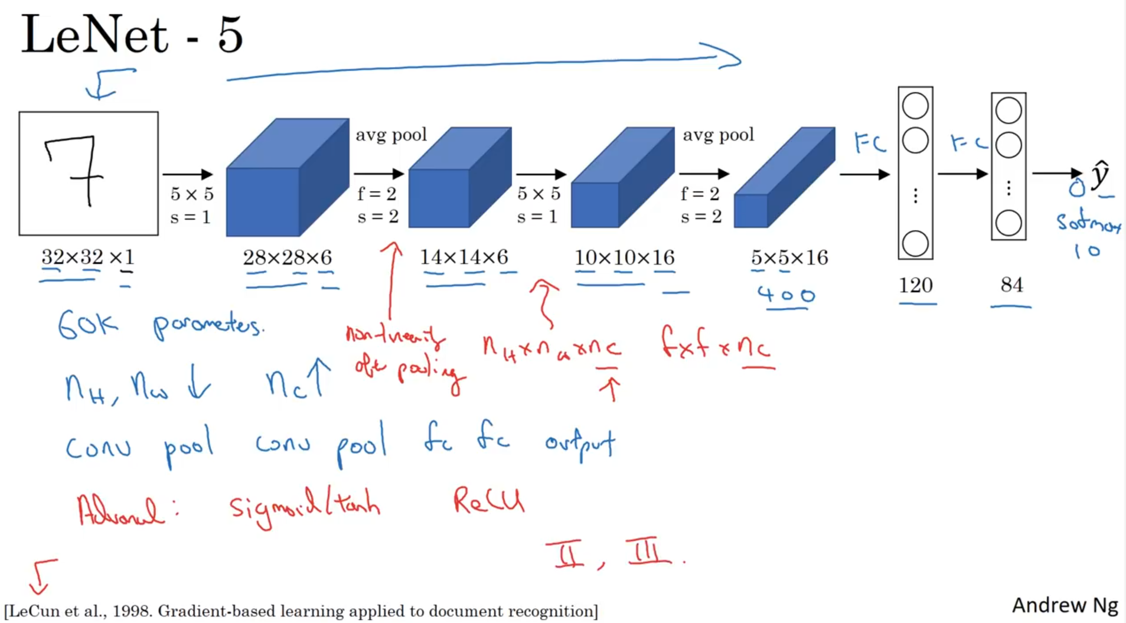
LeNet
03

Slide 9
04
AlexNet

Slide 10
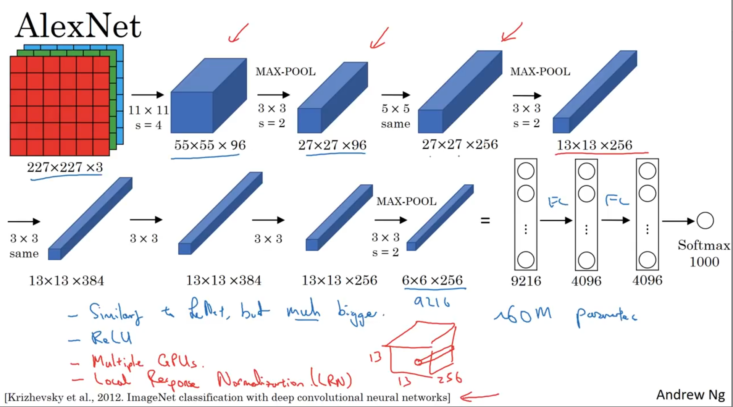
AlexNet
04

Slide 11
Let’s code together

Slide 12
05
ResNet

Slide 13
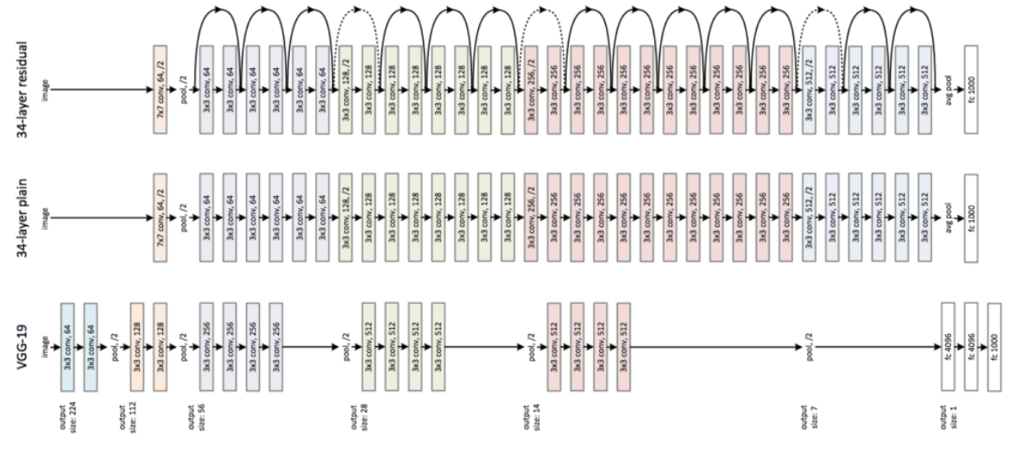
ResNet
05

Slide 14
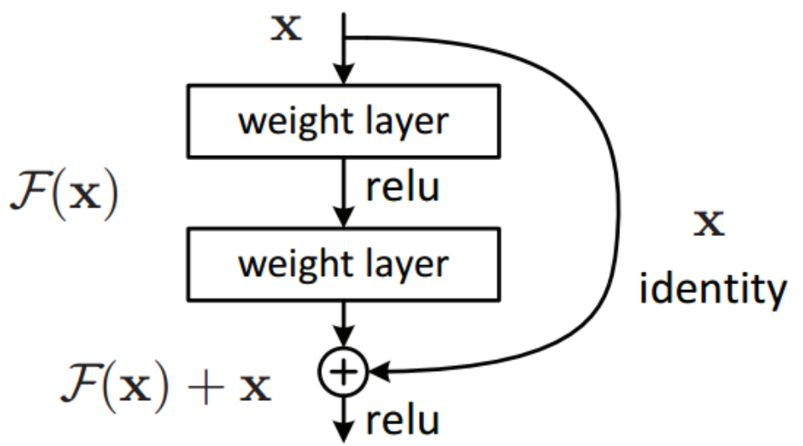
ResNet
05

Slide 15
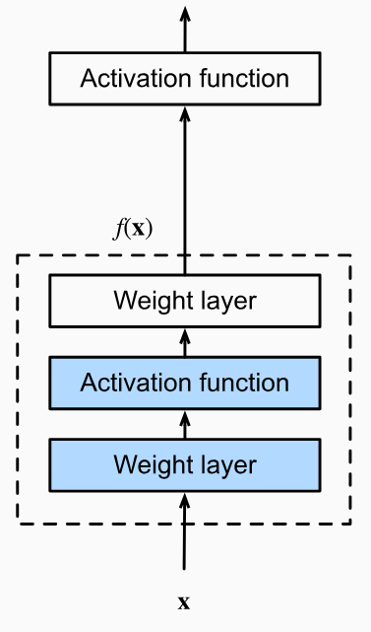
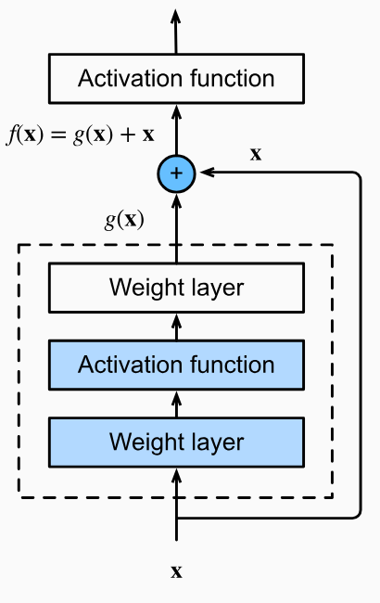
ResNet
05
In a regular block (Figure A), the portion within the dotted-line box must directly learn the mapping f(x)
In a residual block (Figure B), the portion within the dotted-line box needs to learn the residual mapping g(x)=f(x)-x
Figure A
Figure B

Slide 16
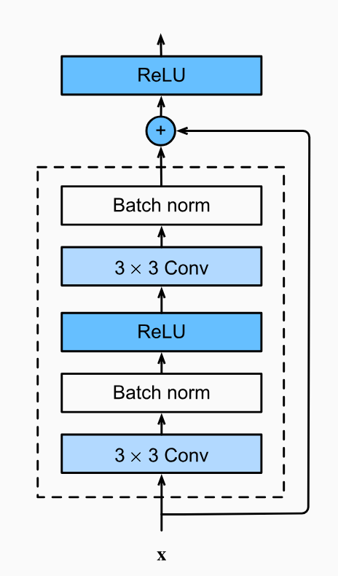
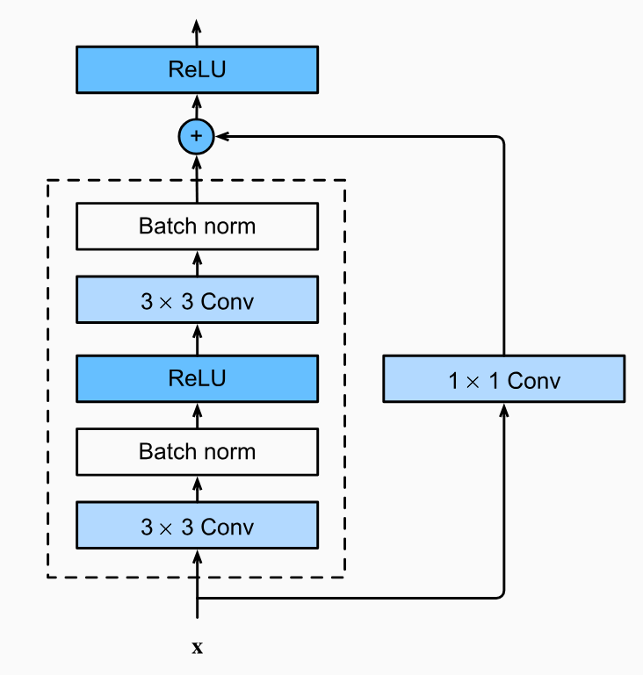
ResNet
05
The structure on the left is where we add the input to the output before applying the ReLU nonlinearity whenever use_1x1conv=False
The structure on the right is where we adjust channels and resolution by means of a 1 x 1convolution before adding.

Slide 17
ResNet
05
Sequential vs Functional API
The Sequential model is a linear stack of layers, where each layer has exactly one input tensor and one output tensor. It is suitable for building simple models and plain CNN models with a single input and output, where the data flows sequentially through the layers.
Functional API allows for more complex model architectures with multiple inputs, multiple outputs, shared layers, multiple models, skip connections, and more. It provides a more flexible way to define the connectivity between layers.

Slide 18
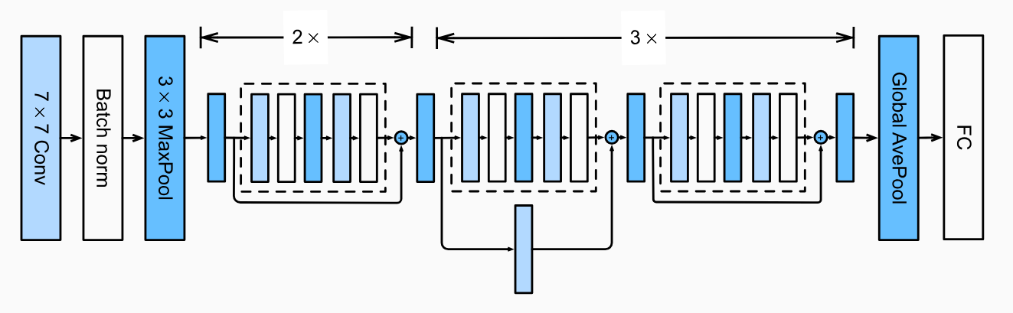
ResNet
05
2x
2x
There are 4 convolutional layers in each module (excluding the convolutional layer). Together with the first convolutional layer and the final fully connected layer, there are 14 layers in total. By configuring different numbers of channels and residual blocks in the module, we can create different ResNet models.

Slide 19
Let’s code together

Slide 20
06
VGGNet

Slide 21
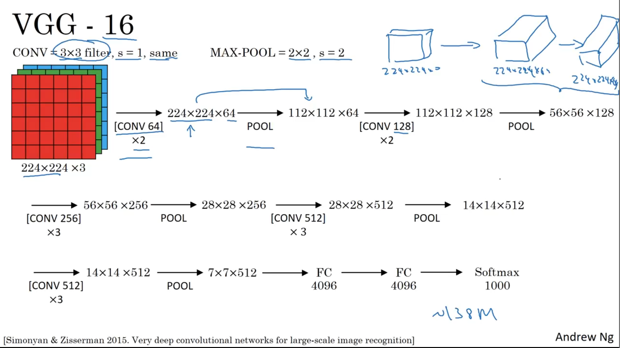
VGGNet
06

Slide 22
Assignment 2

Slide 23
VGGNet Family
06
Implement the VGG 16 network using scratch and pretrained model.
Deadline: Before next Friday Class (23/06/2023)

Slide 24
Assignment 3

Slide 25
VGGNet Family
06
Implement the ResNet 18 Pretrained model for Transfer learning.
Deadline: Before next Tuesday’s Class (27/06/2023)

